Slide 1
BPC - Data and AI Platform -- Using AWS Cloud Infrastructure
Shanker Valipireddy

Slide 2
Executive Summary
Objective and Scope
The proposed work plan aims to implement ChemBERTa, a large-scale self-supervised pretraining algorithm, for molecular property prediction in the BPC company's workflow
The project will be divided into several stages, including data preparation, pre-training, fine-tuning, and deployment.
A detailed Gantt chart with timelines and milestones for each stage is provided. The project will require resources such as personnel, hardware, and cloud resources. A detailed breakdown of costs, including personnel costs and hardware/cloud costs, is provided. Architecture diagrams provided for both ETL and ML Model Training/Deployment
Key Deliverables :
The key deliverables of the project include a trained model and a report on the performance of the model
Potential Outcomes:
The potential outcomes of the project include improved accuracy in molecular property prediction and increased scalability. The skill sets required for the project include proficiency in machine learning and data engineering. The personnel required for each stage of the project are outlined in the summary deck

Slide 3
Project Introduction
chemBERTa model advantages:
ChemBERTa: A collection of BERT-like models applied to chemical SMILES data for drug design, chemical modelling, and property prediction
ChemBERTa-2 is a BERT-like transformer model that learns molecular fingerprints through semi supervised pretraining of the language model. ChemBERTa-2 trained over a large corpus of SMILES strings, a well-known text representation of molecules. SMILES, is its own language, with a simple vocabulary, consisting of a series of characters representing atom and bond symbols, and very few grammar rules. ChemBERTa-2 explores the scaling hypothesis that pretraining effectively on larger datasets can yield improved performance, using the largest training dataset in molecular representation learning

Slide 4
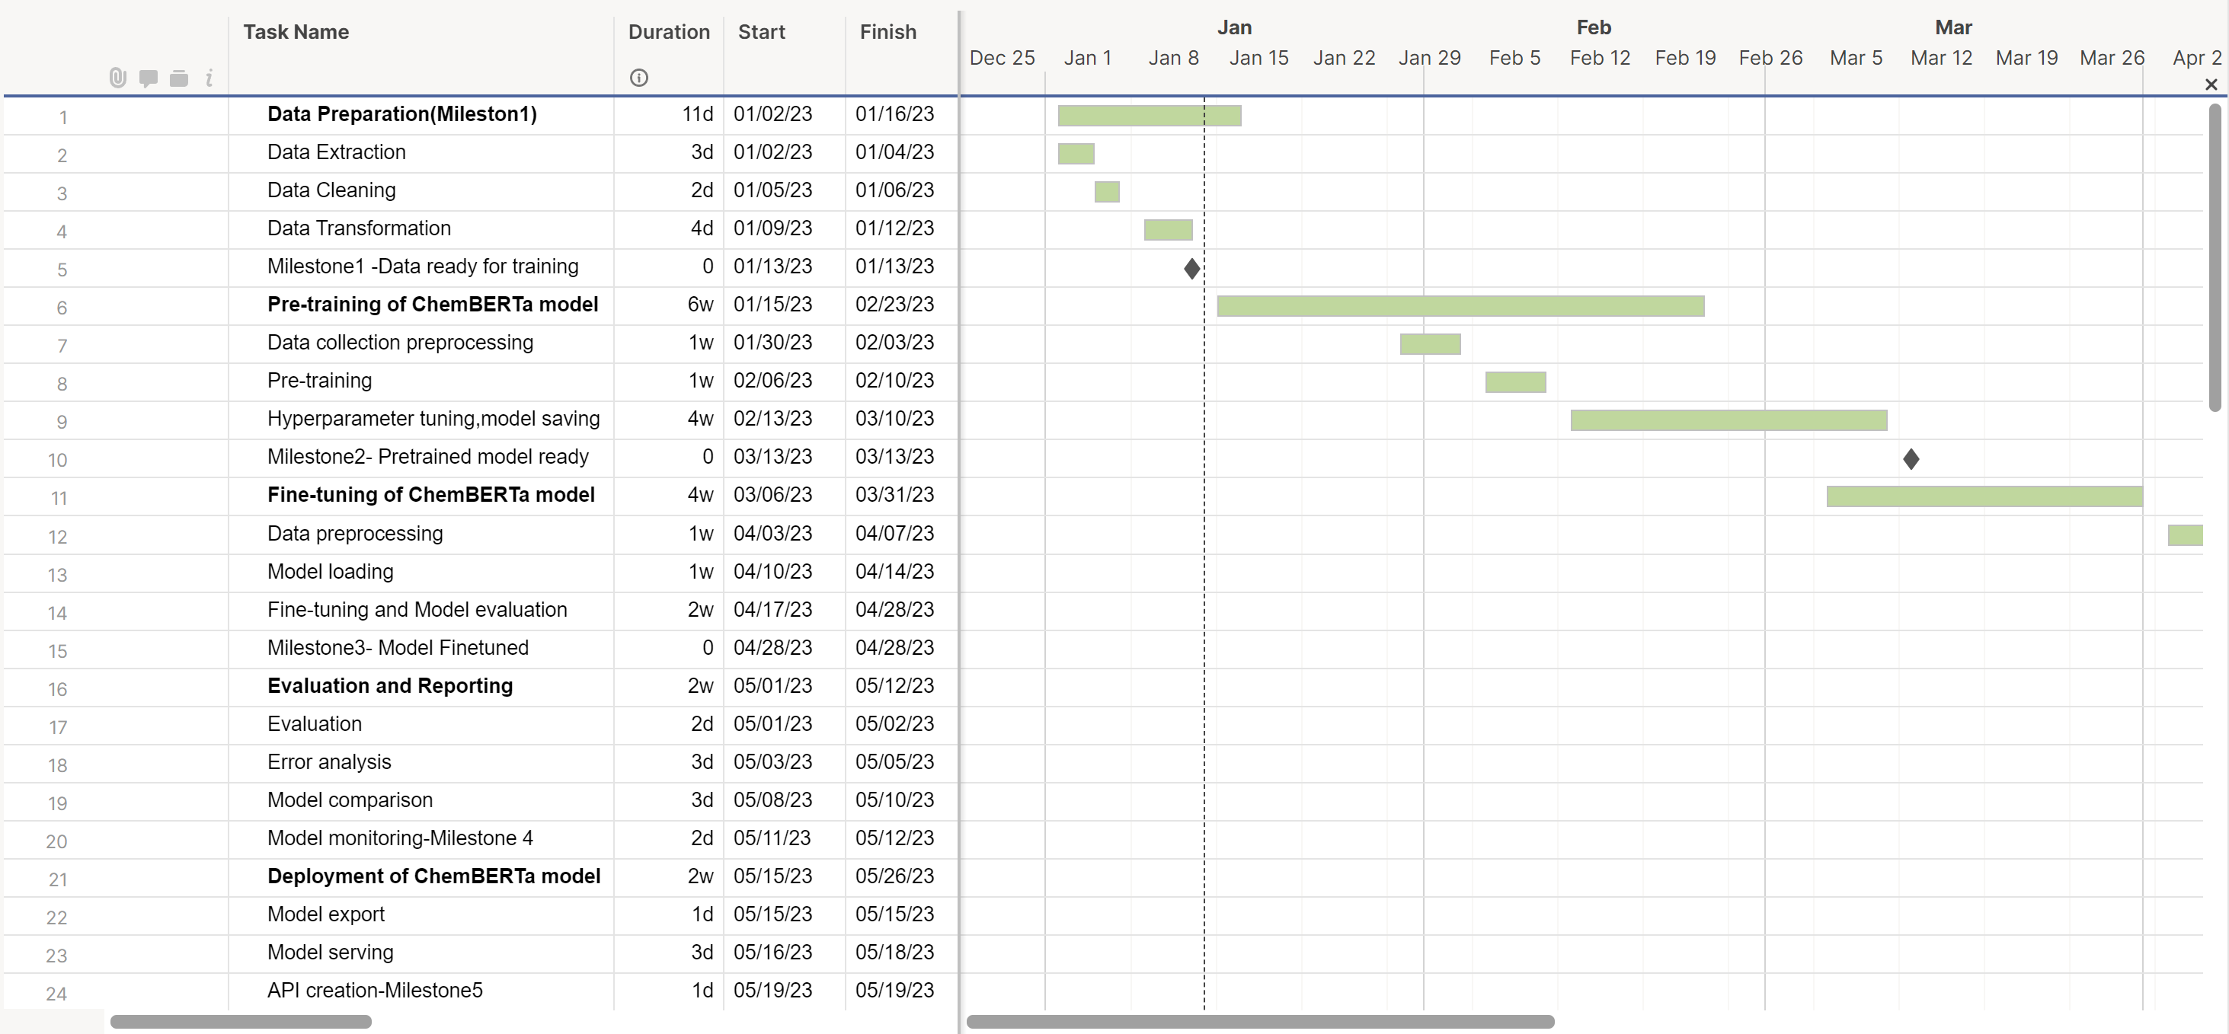
Work Plan- Gantt Chart
Stages:
Data Preparation: This stage involves ETL tasks involves data extraction, transformations and loading into destination DB/DW
Pre-Training: This stage typically involves several sub-tasks Hyper parameter tuning, pre-training etc..
Fine-tuning: It will take Pre-trained ChemBERTa model fine-tune the model which will be used for, such as predicting properties, generating SMILES.
Evolution and Reporting: This stage involves Model evolution, error analysis and compare to other models.
Deployment: This stage involves Model deployment in containerized environment and Creating endpoint to be accessed by users.

Slide 5
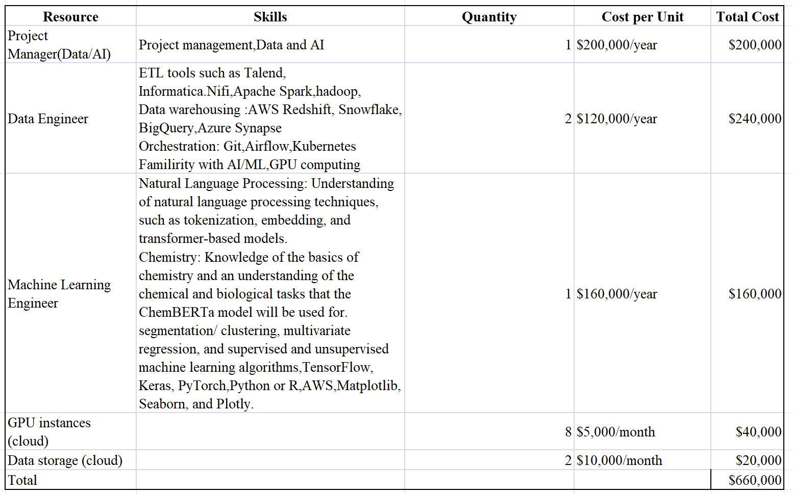
Resources and Costs
Comments:
Cost depends on availability of resources, such as personnel, equipment, and materials. Availability help to identify any constraints that may affect the project schedule or cost
Review and revise: Regularly review and revise the resource and cost estimates. This ensures the project is on schedule and within budget
Additional costs may incur as the project progresses

Slide 6
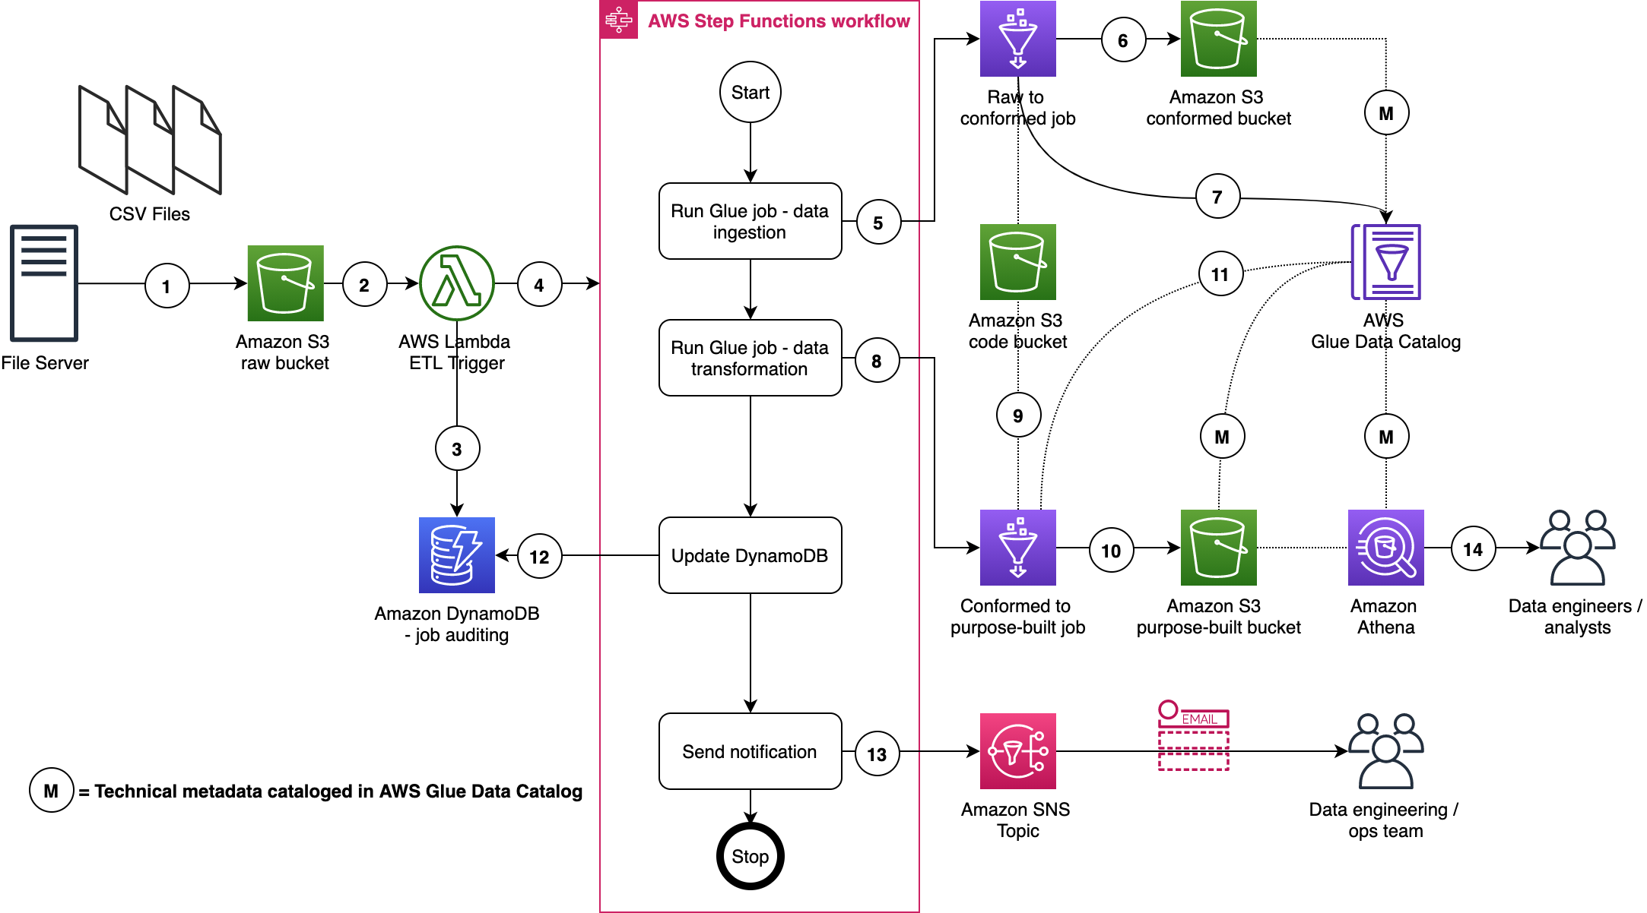
AWS Data Lake ETL Architecture
AWS Data Lake ETL Steps:
A file server uploads files to the S3 raw bucket of the data lake. The file server is a data producer and source for the data lake. We assume that the data is pushed to the raw bucket
Amazon S3 triggers an event notification to the Lambda function
The first state written indicates the AWS Step Function start.
The function starts the state machine.
The state machine runs an AWS Glue job (Apache Spark).
The job processes input data from the raw zone to the data lake conformed zone. The job also converts CSV input data to Parquet formatted data
The job updates the Data Catalog table with the metadata of the conformed Parquet file.
A second AWS Glue job (Apache Spark) processes the input data from the conformed zone to the purpose-built zone of the data lake
The job fetches ETL transformation rules from the Amazon S3 code bucket and transforms the input data
The job stores the result in Parquet format in the purpose-built zone

Slide 7
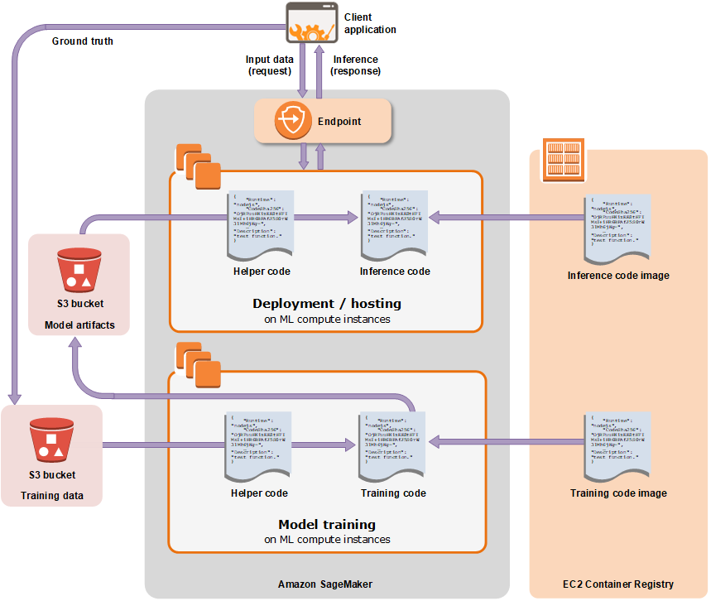
AWS ML Training and Deployment Architecture
AWS Data Lake ETL Steps:
Training job : SageMaker launches the ML compute instances and uses the training code and the training dataset to train the model. It saves the resulting model artifacts and other output in the S3 bucket
After the training, machine learning model can be deployed using Amazon SageMaker to get predictions
We can also use Amazon ECS and API Gateway to create endpoint which will be accessed by many users.

Slide 8
Thanks

